Slide 1









Macau AI Challenge 2019
Host Units:
Department of Computer and Information Science
Support Units:

Slide 2

The information you want to know…

Slide 3

2nd AI Workshop Session 4
Ryan L.H. U 余亮豪
Associate Professor State Key Lab of Internet of Things for Smart City
Department of Computer and Information Science University of Macau

Slide 4
Challenge Introduction
1
Let’s start with the first part of slides

Slide 5





Working Team
University of Macau
Prof. Ryan Leong Hou U (余亮豪)
Research interests: Big Data Processing
Prof. Bob Yibo ZHANG (張一博)
Research interests: Image Processing
Prof. Derek Fai Wong (黃輝)
Research interests: Natural Language Processing
Prof. Long CHEN (陳龍)
Research interests: Machine Learning
Prof. ShirleyWeng In SIU (蕭詠然)
Research interests: Bioinformatics
Alibaba Cloud
Emma WU

Slide 6
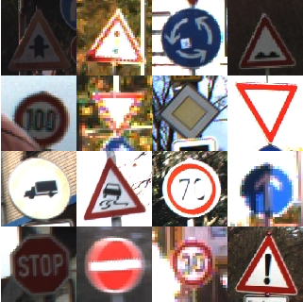
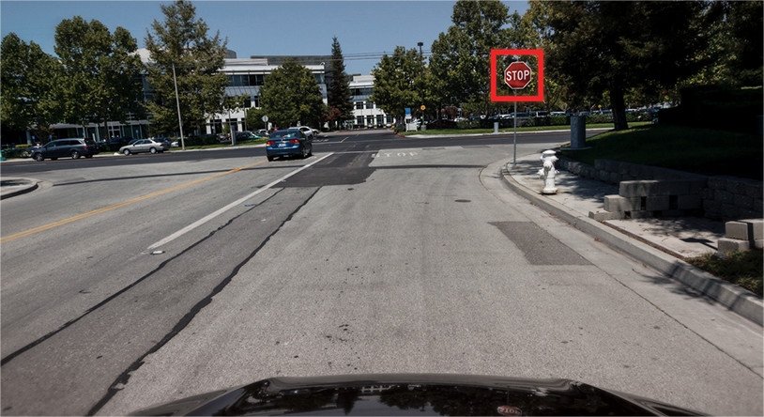
Challenge: Traffic Sign Classification
The challenging part of this task lies in the robustness of your proposed method(s) in different real-life situations, such as low light conditions, obstructions and far-away signs.

Slide 7
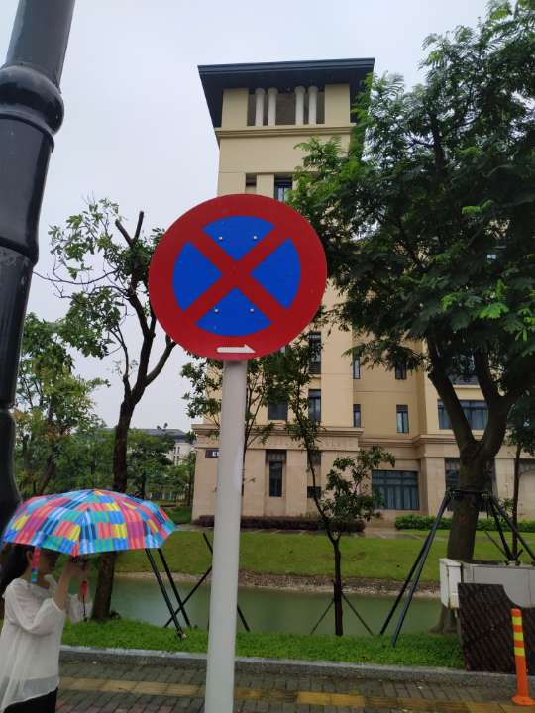
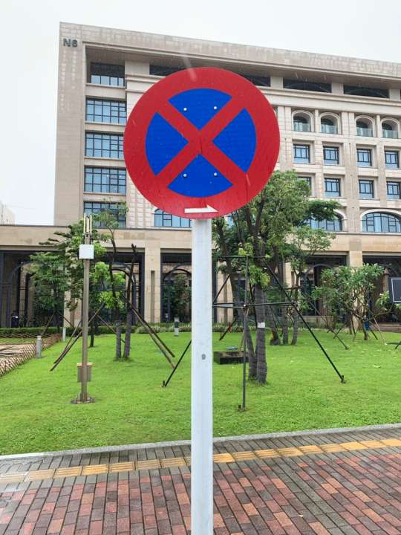
Input and Output
Given a photo and a labelled rectangle, our task is to identify the traffic sign inside the rectangle
INPUT
Image
Rectangle (x1, y1, x2, y2)
OUTPUT LABLE ID

Slide 8
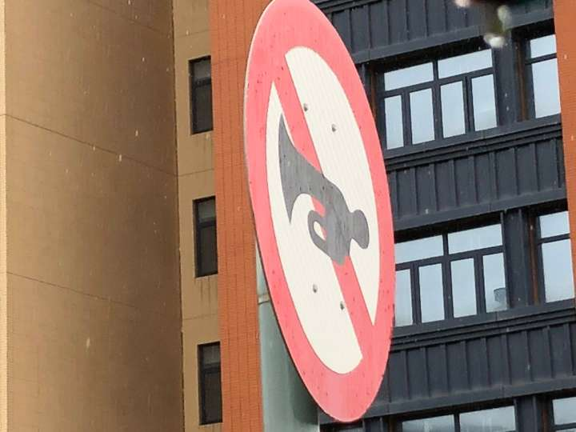
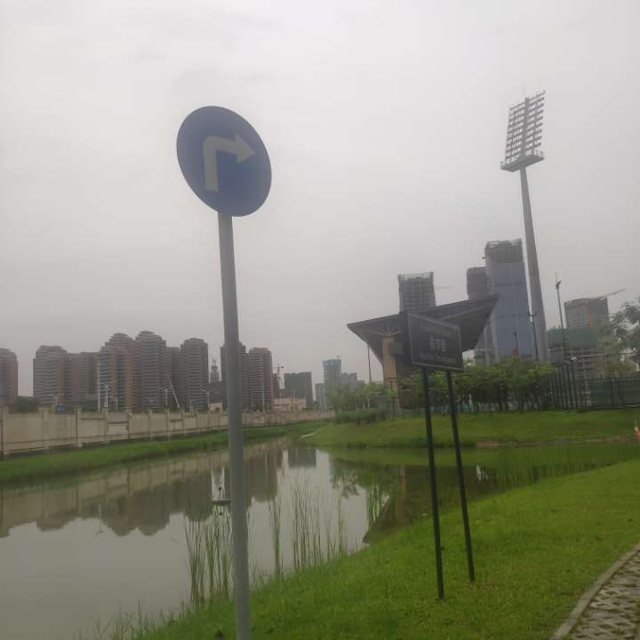
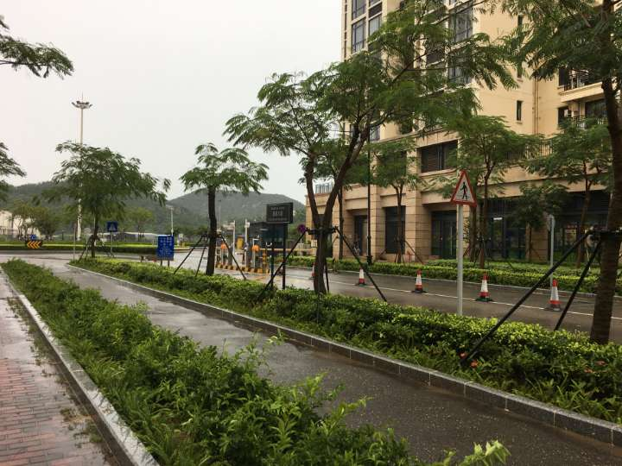
Is the challenge challenging?
Well, we could say no to some photos. However,

Slide 9
The Flow Path of Challenge
Registration
Collecting Data & Training Models
Evaluating Models
Prizes
Presenting @ IJCAI 2019

Slide 10
Registration
2
Let’s work together

Slide 11
Registration
The registration detail can be found
http://conferences.cis.umac.mo/aichallenge/index.php/challenges/team-registration/
Basically, it is a team competition and we accept a group of 5 students (at most)
After we confirmed your eligibility, then we will offer
A Team Account for Data Collection
An Evaluation Account for Eval AI
A Remote Access Account on a GPU Computer AlibabaCloud
A Remote Access Account on GPU computers in UM Centre for Science and Engineering Promotion (working with ICTO)

Slide 12
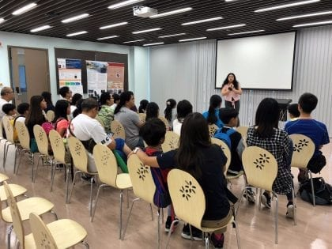
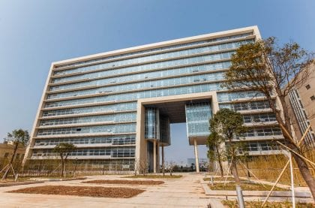
澳門中小學生科技實踐基地科學暨工程科普推廣中心
https://umstem.um.edu.mo/en/

Slide 13
Data Collection
2
Let’s work together

Slide 14
Data Labeler (數據民工)
We have already developed a system to collect data
http://degroup.cis.um.edu.mo/aicom/pages/home.html

Slide 15
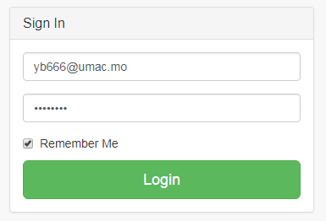
Login

Slide 16
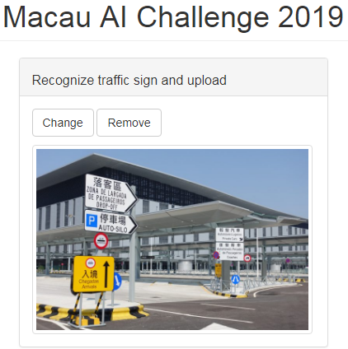
Login
Choose Image

Slide 17
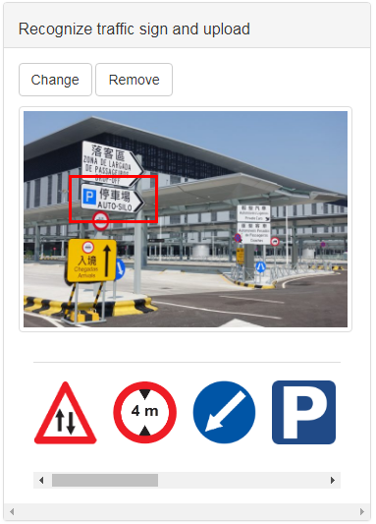
Login
Choose Image
Recognize Traffic Sign

Slide 18
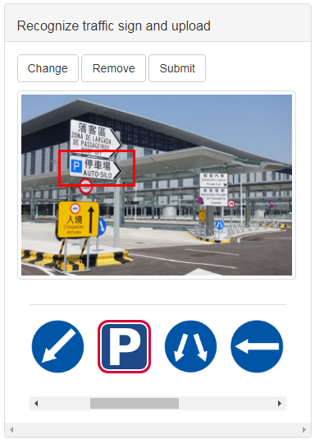
Login
Choose Image
Recognize Traffic Sign
Select Label Matched

Slide 19
Login
Choose Image
Recognize Traffic Sign
Select Label Matched
Upload

Slide 20
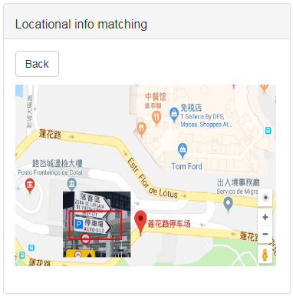
Login
Choose Image
Recognize Traffic Sign
Select Label Matched
Upload
Match Location

Slide 21
Step 1. Login your account
Step 2. Choose your image

Slide 22
Step 5. Upload information
Step 3. Recognize traffic sign
Step 4. Select label matched

Slide 23
Step 6. Showing locational information

Slide 24
Model Development
3
Follow the codes of the workshops

Slide 25
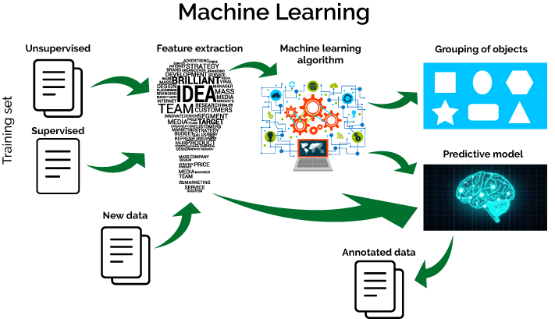
What’s Machine Learning?
Session 1
Session 2
Session 3 & 4
Session 1

Slide 26
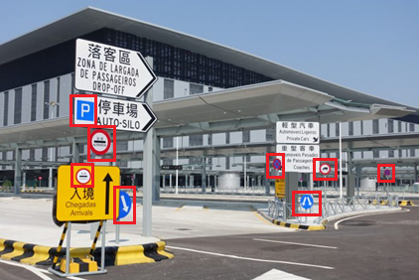
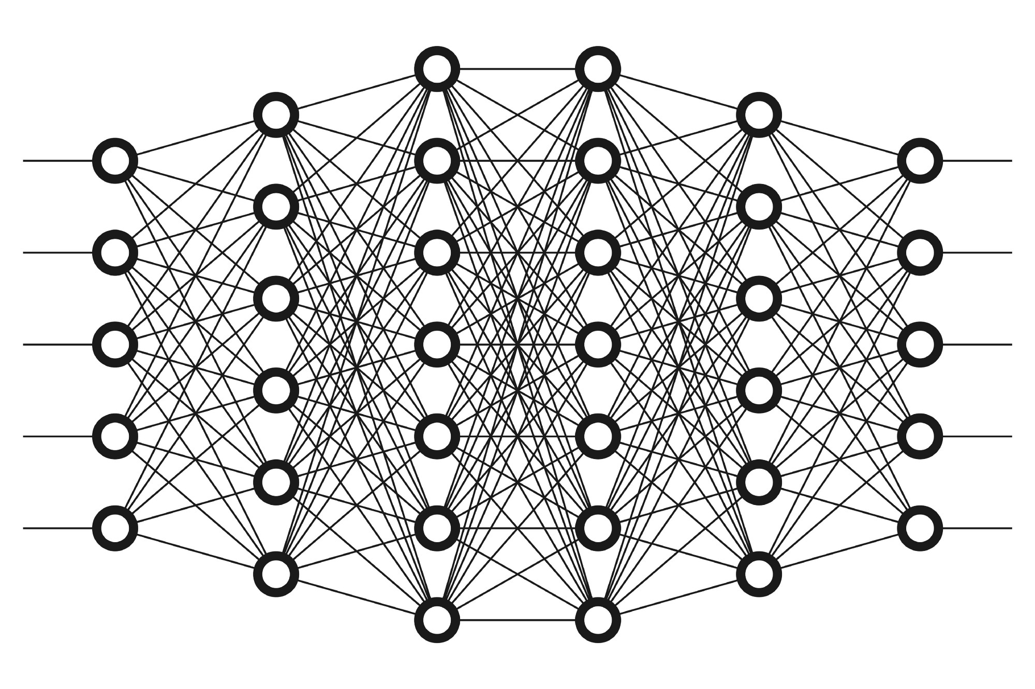
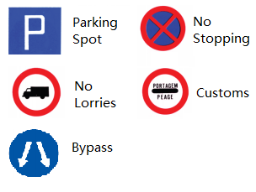
Two-step Processes
Training on labeled images
Evaluating on testing images
Labeled images
Training a learning model
(e.g., Neural Network)
Testing images

Slide 27
GitHub Inc.
https://github.com/RyanLHU/MacauAIChallenge2019
and other image classification repository
GitHub is one of your best friends to find the solution of some technical problems
Develop on Jupyter Notebook

Slide 28
IJCAI 2019
4
Presenting your project

Slide 29

The International Joint Conference on Artificial Intelligence (IJCAI) 2019
The 28th International Joint Conference on Artificial Intelligence (IJCAI) is a gathering of artificial intelligence researchers and practitioners for scientific and educational purposes, including dissemination of information on Artificial Intelligence in which cutting-edge scientific results are presented.
IJCAI-19 will be hosted in Macao. This will be the second time that IJCAI is held in China.
We expect 4000+ top AI researchers to attend the conferences and present their latest development.

Slide 30
Presenting your Solution(s)
Present your solution(s) in a session of IJCAI 2019
Exhibition Hall in Venetian Macau
We will invite some international prestigious professors to be the judgers, e.g., Zhihua Zhou 周志華 (NJU), Qiang Yang 楊強 (HKUST and WeBank)

Slide 31
Evaluation System
5
EvalAI hosted on AlibabaCloud

Slide 32
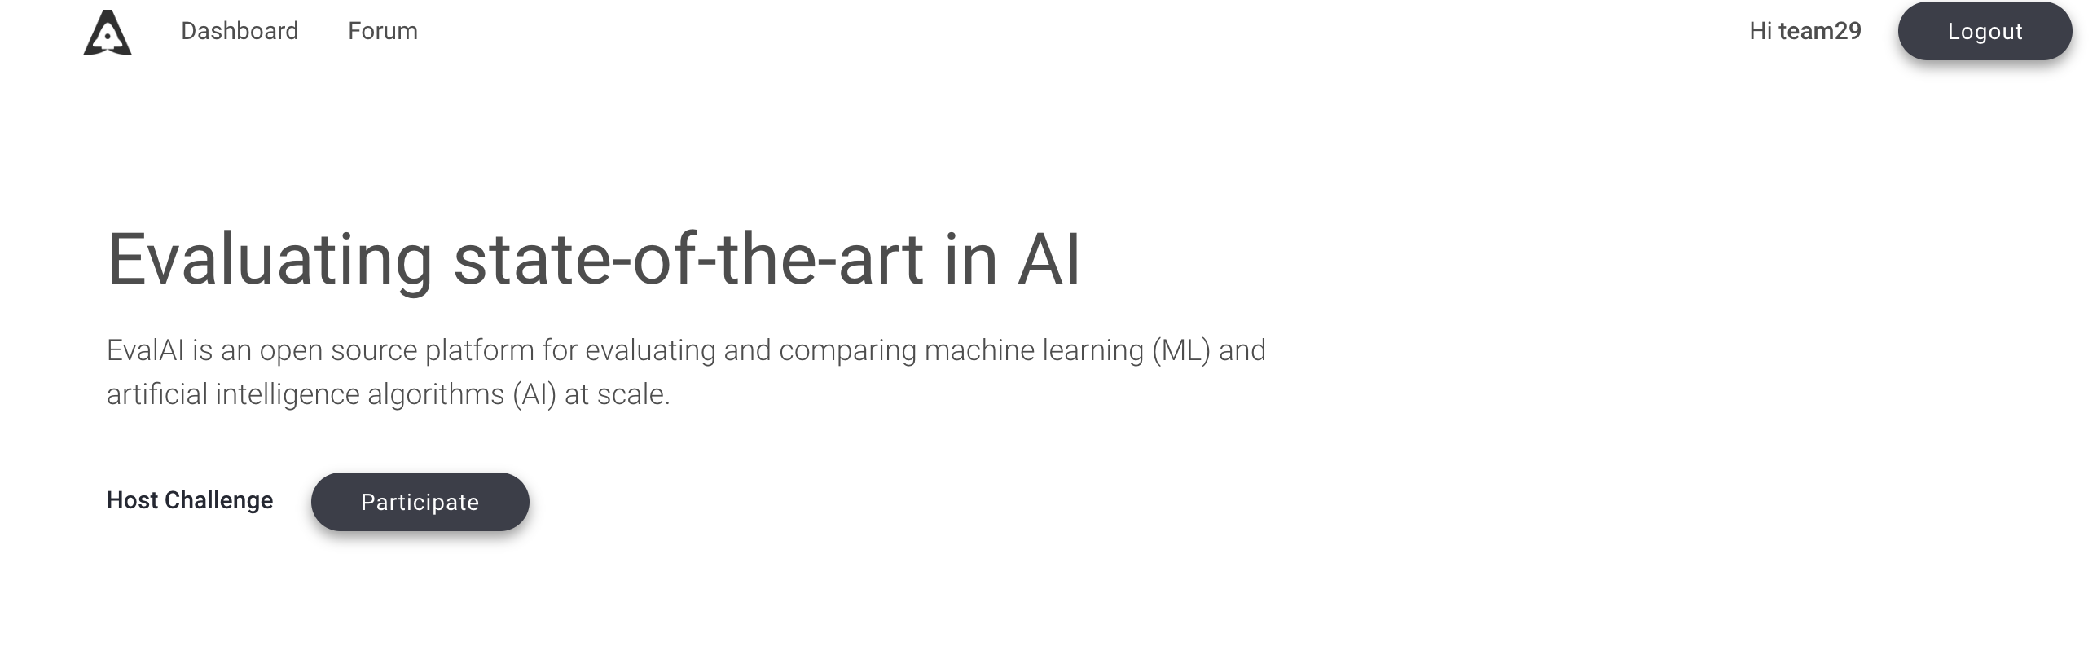
Evaluation System
http://47.244.204.238:8888/

Slide 33

Step 6. Showing locational information

Slide 34
Multi-Stage Evaluation
We will offer several testing stages for your preparation
At each round of testing stages, we will offer a new set of labelled photos for your model learning
The final round will start in Mid of July
1st testing stage
2nd testing stage
3rd testing stage
Final Stage

Slide 35
Prizes
6
Prepare well and win the challenge

Slide 36
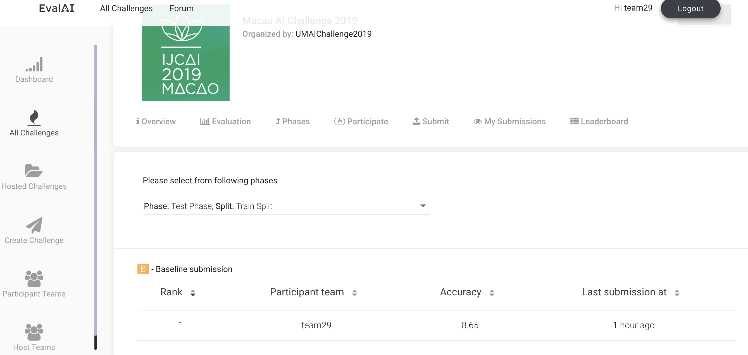
Accuracy Awards
Try your best to improve the accuracy of your solution(s)

Slide 37
Innovation Awards
The innovation level is judged by the presentation on IJCAI 2019
We will invite international and local AI expertise to
assess your innovation
give you comments

Slide 38
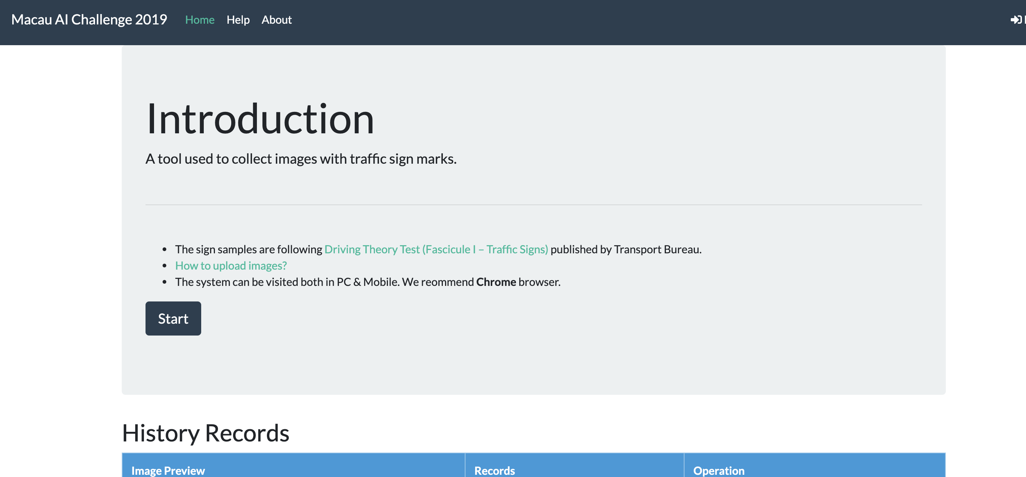
Data Contribution Awards
This award is mainly based on your contributions in the Data Collection System

Slide 39
Challenge (2)
7
Let’s try sth more advanced

Slide 40
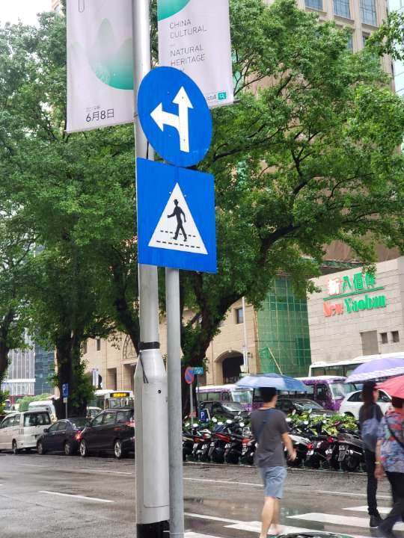
Challenge (2) – Traffic Sign Identification
The challenge will become more challenging if we change it from “classification” to “identification”
INPUT
Image
Rectangle (x1, y1, x2, y2)
OUTPUT LABEL ID1, RECT1
LABEL ID2, RECT2
…

Slide 41
Introduction to Image Segmentation Techniques
The challenge will become more challenging if we change it from “classification” to “identification”

Slide 42
Introduction to Image Segmentation Techniques
We take an image as input and pass it to the ConvNet, which returns the feature map for that image
Region proposal network (RPN) is applied on these feature maps. This returns the object proposals along with their objectness score
A RoI pooling layer is applied on these proposals to bring down all the proposals to the same size
Finally, the proposals are passed to a fully connected layer to classify and output the bounding boxes for objects. It also returns the mask for each proposal
Further reading
https://www.analyticsvidhya.com/blog/2018/10/a-step-by-step-introduction-to-the-basic-object-detection-algorithms-part-1/?utm_source=blog&utm_medium=image-segmentation-article

Slide 43
Future Challenge
8
More interesting to me
https://blog.floydhub.com/an-introduction-to-q-learning-reinforcement-learning/

Slide 44
An introduction to Q-Learning: Reinforcement Learning

Slide 45
A Simple Environment
We are to build a few autonomous robots for a guitar building factory. These robots will help the guitar luthiers by conveying them the necessary guitar parts that they would need in order to craft a guitar.
These different parts are located at nine different positions within the factory warehouse. Guitars parts include polished wood stick for the fretboard, polished wood for the guitar body, guitar pickups and so on.

Slide 46
The states
The states are the locations. The location in which a particular robot is present in the particular instance of time will denote its state.
Machines understand numbers rather than letters. So, let’s map the location codes to numbers.

Slide 47
The actions
In our example, the actions will be the direct locations that a robot can go to from a particular location.
Consider, a robot is at the L8 location and the direct locations to which it can move are L5, L7 and L9. The below figure may come in handy in order to visualize this.

Slide 48
The rewards
By now, we have the following two sets:
A set of states: S=0,1,2,3,4,5,6,7,8
A set of actions: A=0,1,2,3,4,5,6,7,8

Slide 49
The rewards
L6 is the top-priority location that contains the polished wood for preparing guitar bodies.
This is done by associating the topmost priority location with a very higher reward than the usual ones. Let’s put 999 in the cell (L6, L6):

Slide 50
The Bellman Equation
V(s)=max a (R(s,a)+ γ V(s′))
s = a particular state (room)
a = action (moving between the rooms)
s′ = state to which the robot goes from s
𝜸 = discount factor (we will get to it in a moment)
R(s, a) = a reward function which takes a state s and action a and outputs a reward value
V(s) = value of being in a particular state (the footprint)
We consider all the possible actions and take the one that yields the maximum value.

Slide 51
The Bellman Equation
V(s)=max_{a} (R(s,a)+ γ V(s′))
Suppose the discount factor of 0.9
The room, marked in yellow just below the green room will always have a value of 1.

Slide 52
Modeling stochasticity: Markov Decision Processes
V(s)=max_{a} (R(s,a)+ γ V(s′))
Let’s now consider, the robot has a slight chance of dysfunctioning and might take the left or right or bottom turn instead of taking the upper turn in order to get to the green room from where it is now (red room).
What needs to be changed in the above equation so that we can introduce some amount of randomness here?
V(s)=max_{a} (R(s,a) + γ∑_{s′} P(s,a,s′)V(s′))
P(s, a, s′) - the probability of moving from room s to room s′ with action a

Slide 53
Modeling stochasticity: Markov Decision Processes
V(s)=max a (R(s,a) + γ∑_{s′}P(s,a,s′)V(s′))
P(s, a, s′) - the probability of moving from room s to room s′ with action a
When we associate probabilities to each of these turns, we essentially mean that there is an 80% chance that the robot will take the upper turn.

Slide 54
Transitioning to Q-Learning
V(s)=max_{a} (R(s,a) + γ∑_{s′}P(s,a,s′)V(s′))
Q-Learning poses an idea of assessing the quality of an action that is taken to move to a state rather than determining the possible value of the state (value footprint) being moved to.
Q(s,a) = R(s,a) + γ∑_{s′}P(s,a,s′)V(s′)
Q(s,a) = R(s,a) + γ∑_{s′} (P(s,a,s′)max_{a′}Q(s′,a′))
by recursion

Slide 55
The last piece of the puzzle: Temporal difference
Temporal Difference is the component that will help the robot to calculate the Q-values with respect to the changes in the environment over time.
We recalculate the new Q(s, a) with the same formula and subtract the previously known Q(s, a) from it.
TD(a,s) = R(s,a) + γ∑_{s′} (P(s,a,s′)max_{a′}Q(s′,a′)) – Q(s,a)
The blue part is the new Q(s,a)

Slide 56
The last piece of the puzzle: Temporal difference
TD(a,s) = R(s,a) + γ∑_{s′} (P(s,a,s′) max_{a′} Q(s′,a′)) – Q(s,a)
The equation that we just derived gives the temporal difference in the Q-values which further helps to capture the random changes that the environment may impose.
The new Q(s, a) is updated as the following:
Q_{t}(s,a) = Q_{t−1}(s,a) + αTD_{t}(a,s)
Q_{t}(s,a) = Q_{t−1}(s,a) + α(R(s,a)+γ max_{a′} Q(s′,a′)−Q_{t−1}(s,a))

Slide 57
Flappy bird example
http://sarvagyavaish.github.io/FlappyBirdRL/

Slide 58


